Slide 1

SE401 - Software Quality Assurance and Testing
Introduction

Slide 2
Thought for the Day
Software Testing takes at least twice as long as estimated.

Slide 3
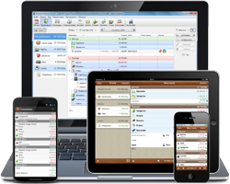





Software is Everywhere

Slide 4
Outlines
What is Software Testing?
Why is Software Testing Important?
Testing Myths
Terminology- Failures, Defects, and Errors
Categories of Software Testing
Principles of Software Testing
SDLC and Testing

Slide 5
What is Software Testing?
It is a systematic process used to identify the correctness, completeness, and quality of developed software. It includes a set of activities conducted with the intent of finding errors in a software so it can be corrected before the product is released to the end users
In simple words: Software testing is an activity that ensures the software system is defect free.
It can be either done manually or using automated tools.

Slide 6
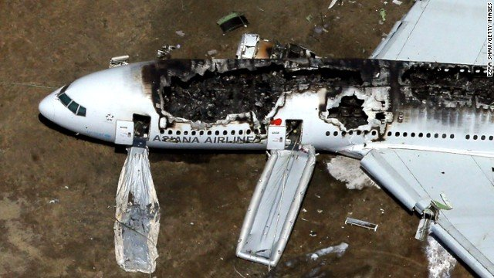
Why Software Testing is Important?
China Airlines Airbus A300
Crashed due to a software bug on April 26, 1994, killing 264 innocent live

Slide 7
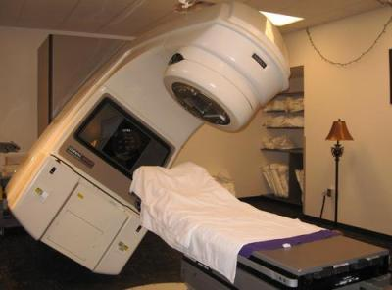
Why Software Testing is Important?
Canada's Therac-25 radiation therapy machine
Malfunctioned in 1985 due to software bug and delivered lethal radiation doses to patients, leaving 3 people dead and critically injuring 3 others.

Slide 8

Why Software Testing is Important?
$1.2 billion military satellite launch
Failed In April of 1999 because of a software bug. The costliest accident in history

Slide 9

Why Software Testing is Important?
US Bank Accounts
A software bug caused 823 customers to be credited $920 million

Slide 10
Economic Impact
The Cost of Poor Software Quality in the US 2020 Report by CISQ Consortium for Information & Software Quality:
The total Cost of Poor Software Quality (CPSQ) in the US is $2.08 trillion
Operational failures 1.56 trillion
Legacy systems 520 billions
We want software systems to be reliable
Testing is how, in most cases, we find out if they are

Slide 11

Launch of MS Windows 98
Bill Gates and Blue Screen of Death

Slide 12
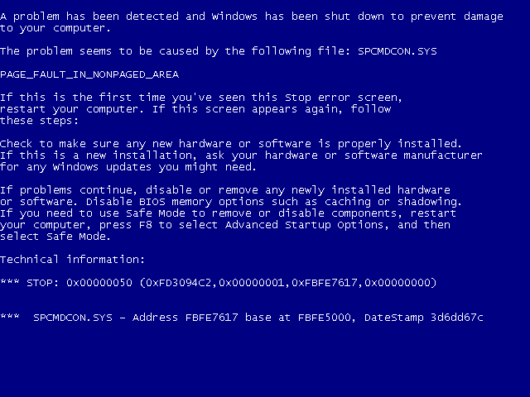
Launch of MS Windows 98
Bill Gates and Blue Screen of Death

Slide 13
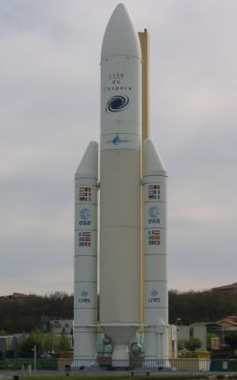
A Case Study: Ariane 5 Launch Vehicle
European expendable launch system
Double the payload capacity of its predecessor Ariane 4
113 successful launches, 3 failures
Flight 501, maiden launch,
June 4, 1996,12:34pm
Notes:
The Guiana Space Centre or, more commonly, Centre spatial guyanais (CSG) is a French and European spaceport near Kourou in French Guiana.

Slide 14
Case Study − Ariane 5: What Happened?
T0 - T0 + 36s : normal
Within SRI 2:
BH (Bias Horizontal) > 2¹⁵
convert_double_to_int(BH) fails!
exception SRI -> crash SRI 2 & 1
OBC disoriented
angle > 20°, huge aerodynamics constraints
boosters separating...
T0 + 39s: self destruction
cost: € 500M
Notes:
Inertial Reference System (SRI)
On-Board Computer (OBC)

Slide 15
Case Study − Ariane 5: Why Did It Happen?
Not a programming error
unprotected conversion = design decision (~1980)
Not a design error
Justified against Ariane 4 trajectory & RT constraints
Problem with integration testing
Theoretically detectable.
But huge test space vs. limited resources
Furthermore, SRI useless at this stage of the flight!
Reuse of a component with a hidden constraint
Precondition : abs(BH) < 32768.0
Valid for Ariane 4, but no longer for Ariane 5
More powerful rocket

Slide 16
Case Study − Ariane 5: Lessons Learned in Software Eng.
Test! Test! Test!
Test! Even when the code is reused.
When reuse, ensure the assumptions are still valid.
When write reusable code, document the assumptions.
Write fail-safe code.
Do not propagate errors.

Slide 17
Why Software Testing is Important?
History is full of such examples. Look for more examples!
Testing is important because software bugs could be expensive or even dangerous.
Software bugs can potentially cause monetary and human loss,

Slide 18
Why Programs fail
In Federalist 51, James Madison wrote: “If men were angels, no government would be necessary.”
If he lived today, Madison might have written: “If software developers were angels, debugging would be unnecessary.”

Slide 19
Why Programs fail
Congratulations!
Your code is complete. It compiles. It runs …
Your program fails. How can this be?
There is a defect in the code. When the code is executed, the defect causes bad behavior, which later becomes visible as a failure.
Before a program can be debugged, we must set it up such that it can be tested — that is, executed with the intent to make it fail.
The first step in debugging is to reproduce the problem in question — that is, to create a test case that causes the program to fail in the specified way.
The first reason is to bring it under control, such that it can be observed.
The second reason is to verify the success of the fix.
Now you will have the fun of testing and debugging!

Slide 20
Why Do We Test?
Testing is expensive.
So are failures!
What do we gain from that cost?
Finding bugs
Leading to
Fixing bugs
Raising the quality of the program or system we are testing
Notes:
1/24/2021
20

Slide 21
Trade-Offs of Cost and Failures
Total Cost of Quality (CoQ) = Cost of Conformance (CoC) + Cost of Non-Conformance (CoNC)
Cost of Conformance
Prevention: quality planning, investment in tools, quality training
Appraisal: testing, inspection
Cost of Non-Conformance
Internal failures: rework
External failure: liability, loss of properties, loss of lives

Slide 22
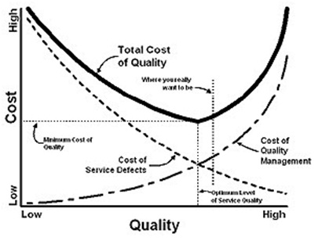
Trade-Offs of Cost and Failures
Testing adds to Cost of Conformance
It must directly reduce Cost of Non-Conformance

Slide 23

Software Testing

Slide 24

Myth #1 in Software Testing
Q: What is the objective of software testing?
A: Testing is to show that there are no
errors/bugs/defects in the software.
Fact:
No!! The main objective of testing is to discover defects.
Testing is a destructive activity.

Slide 25
Myth #2 in Software Testing
Q: What is the objective of software testing?
A: Testing is to ensure that the software does what it is supposed to do.
Fact:
Only partly true.
Testing is also to ensure the software does not do what it is not supposed to do.

Slide 26
Myth #3 in Software Testing
Q: How challenging is software testing?
A: Testing is easier than design and
implementation.
Fact:
Must consider all possible scenarios.
Implied and unstated requirements and threats.
Must be imaginative and creative.
Notes:
Though it’s simple to prepare straightforward test cases, at times testing can be a real challenging task.
Any production issues will, in many cases, backfire first to the testing teams. Why was this scenario not covered in the test plan??
Therefore, a Tester should develop the capability to look or think beyond the requirements mentioned in the test plan or specifications.
This is very important in case of System Testers who are responsible for ensuring that the software product works appropriately from "end-to-end ".

Slide 27

Myth #4 in Software Testing
Q: How challenging is software testing?
A: Testing is an extremely creative and
intellectually challenging task.

Slide 28
A Self Assessment Test

Slide 29
Test the Following Program
The program reads in 3 integer values that represent the lengths of the sides of a triangle.
The program prints a message that states whether the triangle is
Equilateral (all 3 sides are equal)
Isosceles (exactly 2 of the 3 sides are equal)
Scalene (all 3 sides are of a different length)
Write a set of test cases that you feel would adequately test this program.

Slide 30
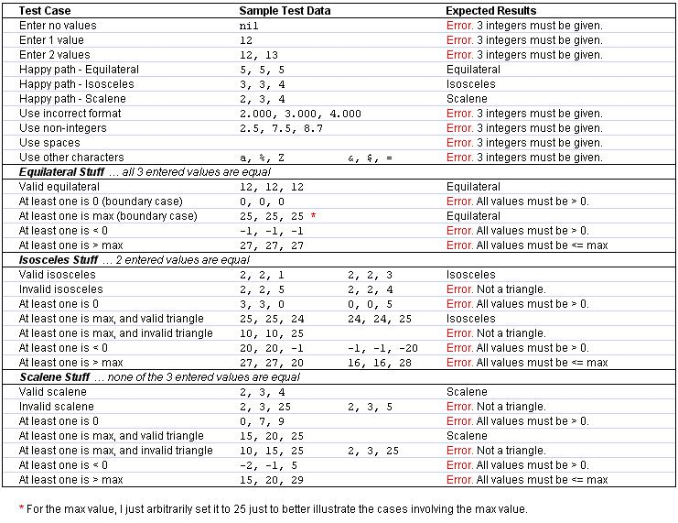

Slide 31
How Will You Do It?
Write a set of test cases that you feel would adequately test this program.
How many cases are needed?
How do you plan to test the program?
Run it once and manually enter the values?
Run it many times with different inputs?
Run it with a file containing a set of lines with test values?

Slide 32
How will you do it?
“Smoke test.”, aka “Hello World!”
Check handling of inputs
Illegal inputs – text instead of integers
Impossible inputs – floating vs. integer
Outrageous values – infinities, max and min values
Not in domain – negative numbers, values outside specifications
Input errors – wrong input, e.g. mis-spellings
Stress test
multiple inputs without restart
run program for long periods of time
Notes:
1/24/2021
32

Slide 33
Software Testing Terminologies

Slide 34
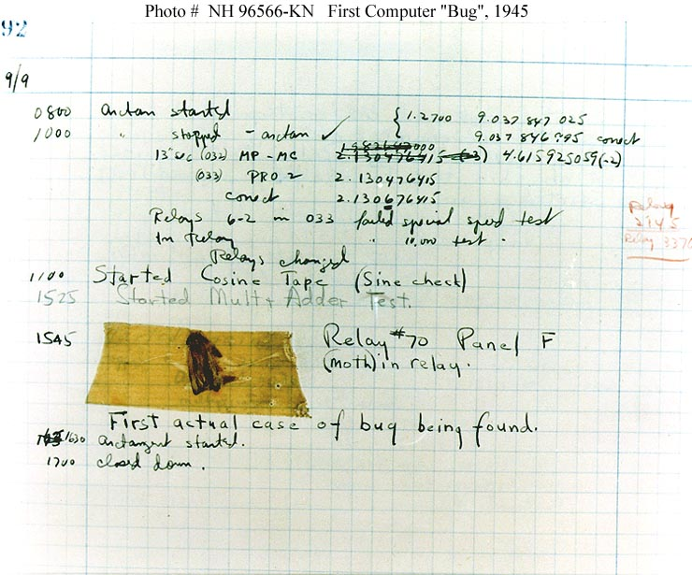
The Very First Software Bug
A moth found trapped between points at Relay # 70, Panel F
Mark II Aiken Relay Calculator
Harvard University
September 9, 1945.
On display in Smithsonian

Slide 36
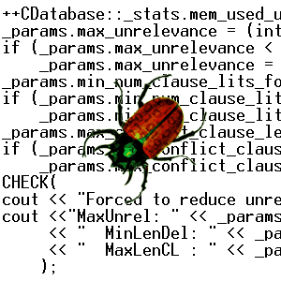
Failures
Failures are
deviation of the observed behavior of a system from its specification, i.e., its expected behavior.
Failures can only be determined with respect to the specifications.
Failures are concerned with the observed behavior and outcome of the system.

Slide 37
Defects
Defects are
flaws in a system that can cause the system to fail to perform its required function
e.g. an incorrect condition or statement.
Defects are concerned with specific parts or components of the system.
Defects are synonymous with faults, bugs.

Slide 38
Errors
Errors are
human actions that result in a fault or defect in the system.
Errors are concerned with the underlying causes of the defects.
Errors are synonymous with mistakes.

Slide 39
The Relations among Failures, Defects, and Errors
A human being makes an error (mistake)
can occur in design, coding, requirements, even testing.
An error can lead to a defect (fault)
can occur in requirements, design, or program code.
If a defect in code is executed, a failure may occur.
Failures only occur when a defect in the code is executed.
Not all defects cause failures all the time.
Defects occur because human beings are fallible
Failures can be caused by environmental conditions as well.

Slide 40
Failures, Defects, and Errors
An example: For any integer n, square (n) = n*n.
int square (int x)
{
return x*2;
}
Error: should be x^2
square (3) = 6
A defect
A failure

Slide 41
Failures, Defects, and Errors
An example: For any integer n, square (n) = n*n.
int square (int x)
{
return x*2;
}
square (2) = 4
A defect
Correct result
Not a failure

Slide 42
JUnit Terminology
Test Case Verdicts
Pass
The test case execution was completed
The function being tested performed as expected
Fail
The test case execution was completed
The function being tested did not perform as expected
Error
The test case execution was not completed, due to an unexpected event, exceptions, or improper set up of the test case, etc.

Slide 43






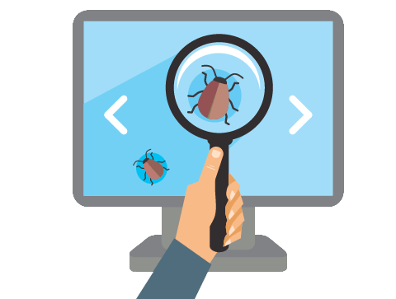




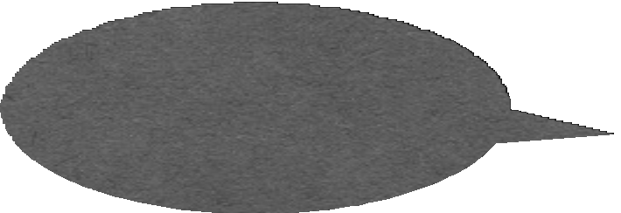


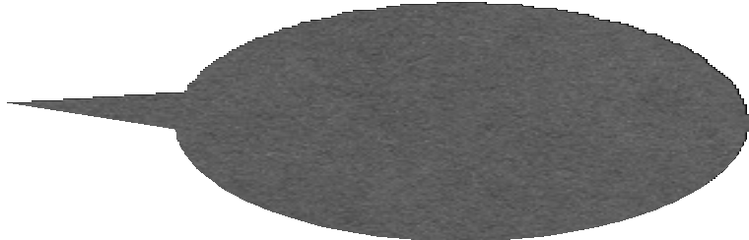


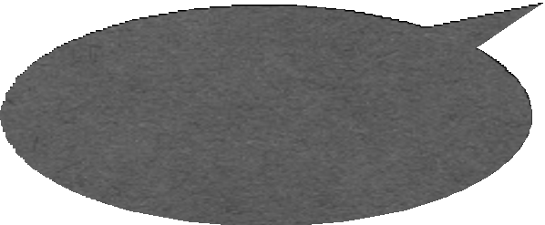

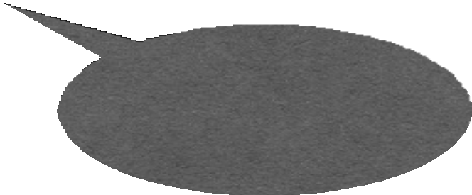



Testing: Concepts

Slide 44
Testing: Concepts
Test case (or, simply test)
An execution of the software with a given test input, including:
•
Input values
Sometimes include execution steps
Expected outputs
•
•
int actual_output=sum(1,2) assertTrue(actual_output==3);
Example JUnit test case for testing “sum(int a, int b)”

Slide 45
Testing: Concepts
•
Test oracle
The expected outputs of software for given input
A part of test cases
Hardest problem in auto-testing: test oracle generation
•
•
int actual_output=sum(1,2) assertTrue(actual_output==3);
Example JUnit test case for testing “sum(int a, int b)”

Slide 46
Testing: Concepts
•
Test fixture: a fixed state of the software under test used as a baseline for running tests; also known as the test context, e.g.,
Loading a database with a specific, known set of data
Preparation of input data and set-up/creation of fake or mock objects

Slide 47
Testing: Concepts
•
Test suite
A collection of test cases
Usually these test cases share similar pre-requisites and configuration
Usually can be run together in sequence
Different test suites for different purposes
•
•
•
Certain platforms, Certain feature, performance, …
Test Script
•
A script to run a sequence of test cases or a test suite automatically

Slide 48
Testing: Concepts
•
Test driver
A software framework that can load a collection of test cases or a test suite
It can also handle the configuration and comparison between expected outputs and actual outputs
•

Slide 49
Testing: Concepts
Test adequacy
We can’t always use all test inputs, so which do we use and when do we stop?
We need a strategy to determine when we have done enough
Adequacy criterion: A rule that lets us judge the sufficiency of a set of test data for a piece of software

Slide 50
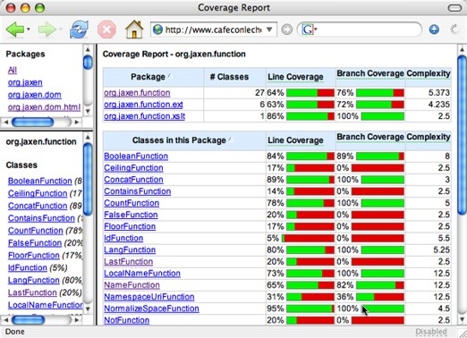
Testing: Concepts
Test adequacy example: test coverage
A measurement to evaluate the percentage of tested code
•
Statement coverage
Branch coverage, ...
Cobertura tool

Slide 51

Granularity of Testing
Unit Testing
Test of each single module
Integration Testing
Test the interaction between modules
System Testing
Test the system as a whole, by developers
Acceptance Testing
Validate the system against user requirements, by customers, without formal test cases
System& Acceptance Testing
Integration Testing
Unit Testing

Slide 52
Software Testing
Software testing is
the process of executing a program (or parts of a program) with the intention of finding defects
The purpose of testing
to find defects.
to discover every conceivable weakness in a software product.
Software testing ≠ Debugging.
Software testing ≠ Quality assurance

Slide 53
Software Testing vs. Quality Assurance (QA)
Software testing is a planned process that is used to identify the correctness, completeness, security and quality of software.
Quality Assurance (QA) is planned and systematic way to evaluate quality of process used to produce a quality product.
The goal of a QA is to provide assurance that a product is meeting customer’s quality expectations.

Slide 54
Software Testing vs. Quality Assurance (QA)
Testing is necessary, but not sufficient for quality assurance
Testing contributes to improve quality by identifying problems.
Quality assurance sets the standards for the team/organization to build better software.

Slide 55
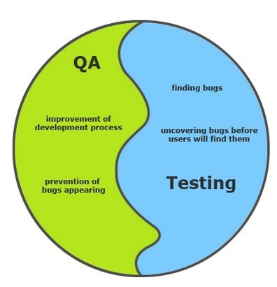
Software Testing vs. Quality Assurance (QA)

Slide 56
Test Cases and Test Suites
Test case
A test case consists of inputs, steps/actions, and expected results, i.e., pass-fail criterion
Test suite
A group of test cases (usually organized around some principles, e.g. smoke test suite)

Slide 57
Test Plan and Testing Process
Test plan
A document that specifies how a system will be tested, including criteria for success, i.e., the exit criteria.
Testing process
The testing process involves developing test plans, designing test cases, running the test cases, and evaluating the results

Slide 58
Techniques for Software Testing

Slide 59
Testing
Testing “Phases”
Unit
Integration
System
User Acceptance Testing
Testing Types
Black-box
White-box
Static vs. Dynamic Testing
Integration: 3 types
Top down
Bottom up
Sandwich
Automated Testing
Pros and cons
Defect tracking

Slide 60
Ad Hoc Testing
Ad hoc testing
Testing carried out informally
No formal test preparation
No recognized test design technique is used
Expected results not defined
Arbitrariness guides the test execution activity
Ad hoc testing is not sufficient

Slide 61
Black Box Testing
Treats a program or system as a black box
Design test cases without the knowledge of internal structure and design of the system
Design test cases based on the functional requirements of the system
a.k.a: functional testing
Send the system inputs, observe the outputs, decide if the system passed or failed the test
Sometimes you don’t have access to source code

Slide 62
White Box Testing
Open up the box!
a.k.a: glass box, clear box, or structural testing
Design test cases by examining the internal design and source code of the program
Require detailed knowledge of its structure
Introduce the idea of measuring coverage:
How adequate, or thorough, is the test suite?

Slide 63
Software Analysis
Software analysis is
the process of finding defects in a program (or parts of a program) without executing the program.
a.k.a. static analysis
Complementary to software testing
Same purpose, different techniques
Software analysis can be
automated, i.e., using tools, static analyzers
manual, e.g., inspection, code review

Slide 64
Categories of Software Testing
Typically Testing is classified into three categories.
Functional Testing
Non-Functional Testing or Performance Testing
Maintenance (Regression and Maintenance)

Slide 65
Categories of Software Testing
Testing Category | Types of Testing (examples)
Functional Testing | Unit Testing Integration Testing Smoke UAT ( User Acceptance Testing) Localization Globalization Interoperability and So on
Non-Functional Testing | Performance Endurance Load Volume Scalability Usability and So on
Maintenance | Regression Maintenance
This is not the complete list of testing types. There are much more types and still adding.
Also, note that not all testing types are applicable to all projects but depend on nature & scope of the project.

Slide 66
Testing vs. Verification
TESTING
Goal: find evidence for presence of failures
Testing: execute a program with the intent of detecting failure
Testing cannot guarantee correctness, i.e., absence of failures
Related techniques: code reviews, program inspections
VERIFICATION
Goal: find evidence for absence of failures
Verification guarantees correctness
Related techniques: code generation, program synthesis (from spec)

Slide 67
Testing vs. Verification
Both, testing and verification attempts to exhibit new failures
Debugging is a systematic process that finds and eliminates the defect that led to an observed failure
Programs without known failures may still contain defects:
If they have not been verified
If they have been verified, but the failure is not covered by the specification

Slide 68
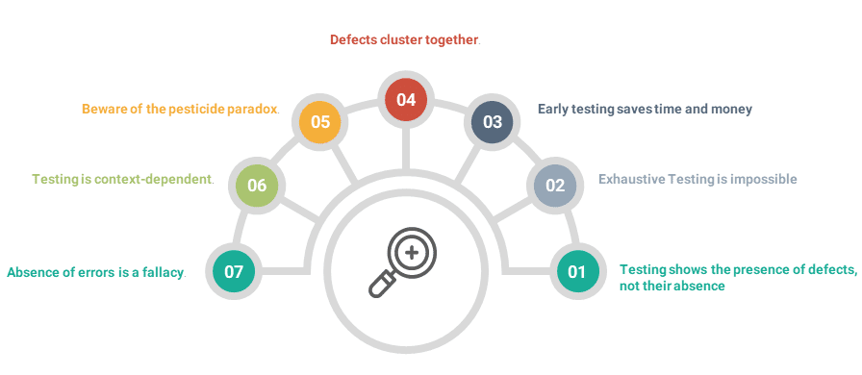
Fundamental Principles of Software Testing

Slide 69
Fundamental Principles of Software Testing
It is important that you achieve an optimum test results
But how do you determine that you are following the right strategy for testing?
For that, you need to stick to some basic testing principles to optimize the testing effort
Here are some common testing principles that are widely practiced in the software industry

Slide 70
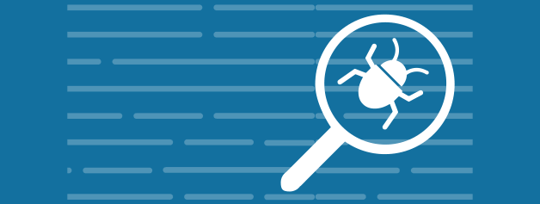
Testing shows presence of defects
Testing talks about the presence of defects and don’t talk about the absence of defects.
i.e. Software Testing reduces the probability of undiscovered defects remaining in the software but even if no defects are found, it is not a proof of correctness.
Despite the thorough testing of a product or application, no one can ensure the product is 100% defect free

Slide 71

Exhaustive testing is not possible
It is impossible to test all the combinations of data, inputs, and test scenarios since it requires lots of time.
Instead, we need the optimal amount of testing based on the risk assessment of the application
Prioritize test cases

Slide 72
Exhaustive Testing is not possible
loop < 20 iterations
Can we exhaustively test a
program?
Let’s consider this simple program
There are 10¹⁴ possible paths!
If we execute one test per millisecond,
it would take 3,170 years to test this program!!
Exhaustive testing is impossible!

Slide 73

Early testing
Testing should start as early as possible in the Software Development Life Cycle.
This allows any defects in the requirements or design phase to be captured in early stages.
It is much cheaper to fix a Defect in early stages of testing.
But how early one should start testing?
It is recommended that you start finding the bug the moment the requirements are defined. (More on this principle is discussed later.)

Slide 74

Defect clustering
Defect Clustering states that a small number of modules contain most of the defects detected. (approximately 80% of the problems are found in 20% of the modules.)
By experience, you can identify such risky modules. But this approach has its own problems:
If the same tests are repeated over and over again, eventually the same test cases will no longer find new bugs.

Slide 75
Pesticide Paradox
If the same set of repetitive tests are conducted, the method will be useless for discovering new defects.
To overcome this, the test cases need to be regularly reviewed & revised, adding new & different test cases to help find more defects.
Testers cannot simply depend on existing test techniques. They must aim continually to improve the existing methods to make testing more effective.
But even after all this testing, you can never claim your product is bug free.

Slide 76

Testing is basically context-dependent
Various products or projects contain different elements, features, and requirements.
Hence, testers cannot apply the same test approach for different projects. For instance, an application in banking industry should require different testing techniques than an entertainment software.

Slide 77
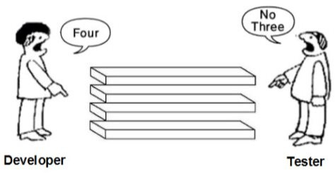
The absence of Errors Fallacy
The software product should not be tested only on the technical side but also on the expectations and needs of users .
Although the testing didn’t show up any bugs in the software, it would not mean that the product is ready to be released since it must be confirmed the testing is conducted thoroughly with the right requirements.
So .. Absence of Error is a Fallacy i.e. Finding and fixing defects does not help if the system build does not fulfill the user’s needs & requirements.

Slide 78
Make No Assumptions
Do not assume that no new defects will be found.

Slide 79
Define Expected Output
Each test case must include the expected output.
The output of each test must be thoroughly inspected.
Preferably: automated inspection, assertions
?
Actual output
Expected output

Slide 80
Test the Invalid and Unexpected
Test input conditions that are
valid and expected
invalid and unexpected
Test a program to see whether it
does not do what it is supposed to do
perform some but not all the required functions
does what it is not supposed to do
perform unnecessary functions, undesired side-effects

Slide 81
Test Independently
A program should be tested by independent testers.
developer
independent tester
Understands the system
Must learn about the system,
but, will test "gently"
but, will attempt to break it
and, is driven by "delivery"
and, is driven by quality

Slide 82
Tool Support is Essential
Some Reasons for Using Tools
Automate repetitive tasks
Avoid typos, etc.
Cope with large programs
Tools Used
Test script
Automated compilation, build and testing: Ant
Automated running of tests: JUnit
Debugging: Eclipse debugger
Code Coverage: Cobertura, EclEmma, JaCoCo

Slide 83
Fundamental Principles Myth
Myth: "Principles are just for reference. I will not use them in practice .“
Fact:
This is so very untrue. Test Principles will help you create an effective Test Strategy and draft error catching test cases.
Experienced testers have internalized these principles to a level that they apply them without even thinking.
Hence the myth that the principles are not used in practice is simply not true.

Slide 84
Limitations of Software Testing

Slide 85
Exhaustive Testing
loop < 20 iterations
Can we exhaustively test a
program?
Let’s consider this simple program
There are 10¹⁴ possible paths!
If we execute one test per millisecond,
it would take 3,170 years to test this program!!
Exhaustive testing is impossible!

Slide 86
Absence of Defects
“Program testing can be used to show the presence of bugs, but never their absence.”
(Dijkstra, 1969)
Testing reduces the probability of undiscovered defects remaining in the software but, even if no defects are found, it is not a proof of absence of defects.

Slide 87
When to Stop Testing?
One of the most difficult problems in testing is not knowing when to stop.
You can use metrics to make a guess. Keep track of the defect rate. When it goes towards zero you can use it as an indicator. Or, …
Even if you do find the last bug, you’ll never know it.

Slide 88
How Much Testing is Enough?
Take into account
the level of risk, including technical, safety, and business risks, and
project constraints such as time and budget.
Testing should provide feedback to stakeholders to make informed decisions
about the release of the software,
for the next development step, or
handover to customers.
Later, we will discuss some techniques for making this decision.

Slide 89
Testing and SDLC

Slide 90
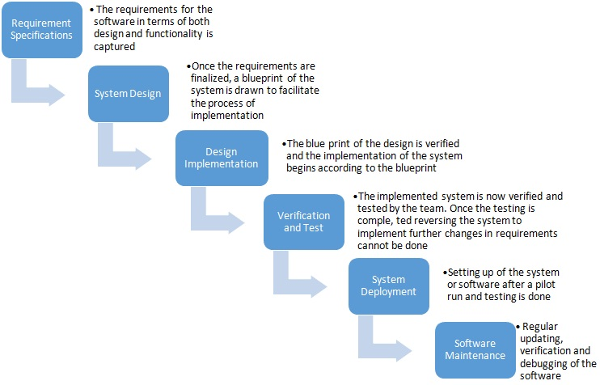
SDLC – Waterfall
Software Development Life Cycle (SDLC), the waterfall model
As you may observe, that testing starts only after implementation is done.
Discuss: what is the affect of delaying testing until after implementation?

Slide 91
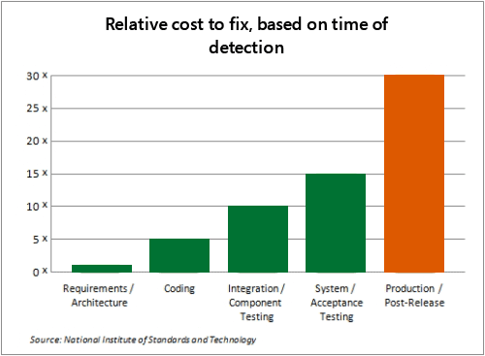
Cost of Fixing Defects across the SDLC
The costs of fixing a defect increases across the development life cycle. The earlier in life cycle a defect is detected, the cheaper it is to fix it.
To address this concern, the V model of testing was developed where, for every phase in the Development life cycle, there is a corresponding Testing phase

Slide 92
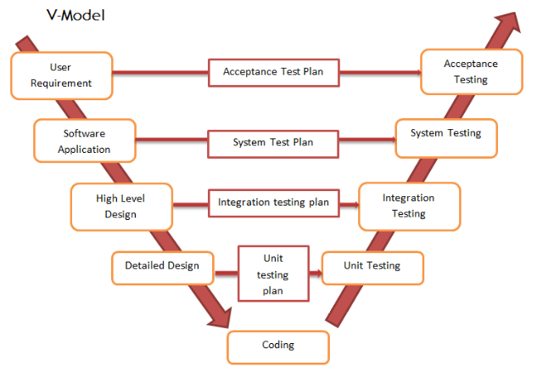
V-Model of Testing
The left side of the model is Software Development Life Cycle - SDLC
The right side of the model is Software Test Life Cycle - STLC
The entire figure looks like a V, hence the name V – model
Achieves the principle “Early Testing”

Slide 93
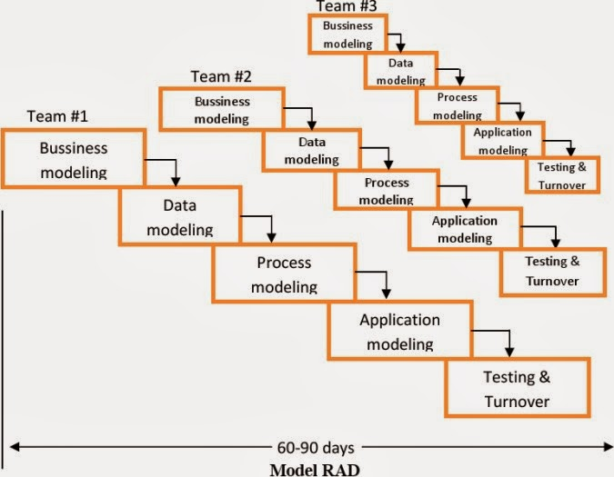
Other Development Models
RAD Model
Spiral Model

Slide 94
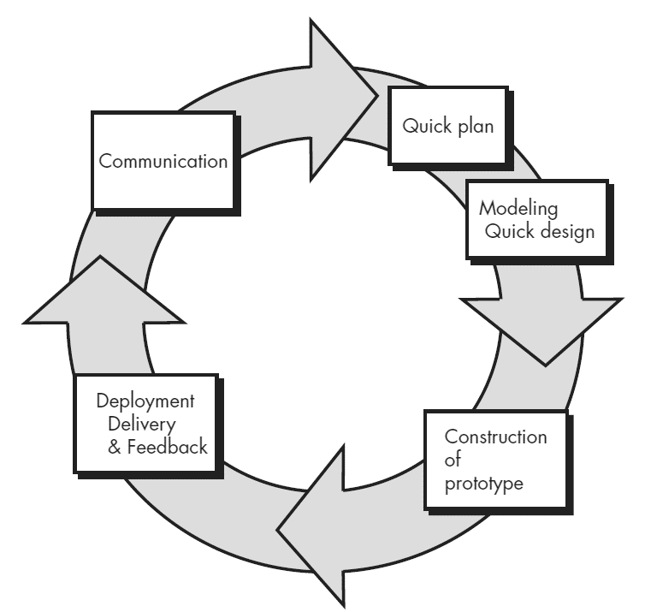
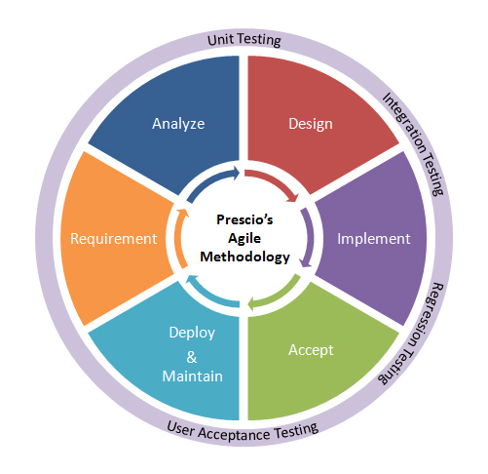
Other Development Models
Prototype Model
Agile Model

Slide 95
SDLC and Testing
It is important to understand that there are various development life cycle models.
Selecting a development model for a project depends on the aims and goals of that project.
Testing is not a stand-alone activity, and it has to adapt to the development model chosen for the project.
In any model, testing should be performed at all levels i.e. right from requirements until maintenance.

Slide 96
Summary – Key Concepts
Objective and principles of testing
Cost of quality
Fundamentals and basic terminologies in testing
Failures, defects, faults, errors, mistakes
Testing, analysis, black-box and white-box testing
Test cases, test suites, test plan, test process
Testing principles
Independent testing
Limitations of testing, exhaustive testing

